Slide 1
이그쉐어_Power Board rev.P0

Slide 2
Block Diagram
LTM4634EV
Triple
3.3VP@5A
MAX1847
Inverting
2VP@5A
6VP@4A
6VN@1A
LTM4619
Dual
3.5VP@4A
5VP@4A
MCU
Power Control
I2C
LTM4622A
Single
12VP@4A
HV9110
HVP1
HV9110
HVN1
HV9110
HVP2
HV9110
HVN2

Slide 3
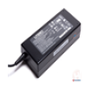

Block Diagram
HVP1
HVN1
Potentiometer
Input Voltage
14V ~ 19V
HVP2
5V
HVN2
D5VP
Analog part
A12VP
I2C
A6VP
A6VN
A3V5P
MCU
ATEMEGA48PA
D3V3P
Enable
Digital part
D2VP
Status

Slide 4
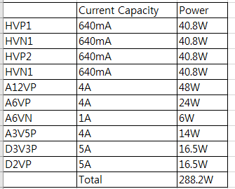
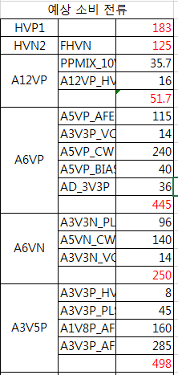
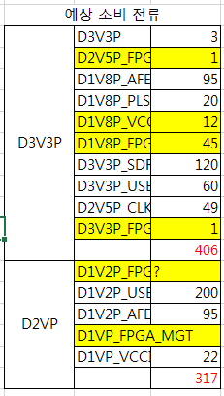
Power & Current
FPGA 예상 소비 전류 추정X

Slide 5
High Voltage

Slide 6
Low Voltage

Slide 7
Low Voltage

Slide 8
Low Voltage

Slide 9
MCU

